Slide 1
Course Buddy
Vamsi Krishna challa,10
Girish Kumar reddy Nagella,56
Shankar pentyala,69

Slide 2
Problem Statement
Student fraternity has a tendency to work along deadlines and many of the times, they tend to forget the deadlines and lose marks even having competency to complete on time. Not only deadlines, many of the student fraternity has a feeling of introvert of not being able to directly interact with the teaching fraternity.
Our COURSE BUDDY application tries to lessen the gap between teaching and student streams and also provide an interface for free flow of communication. Giving it a social media touch, would easily attract the students to make use of it.

Slide 3
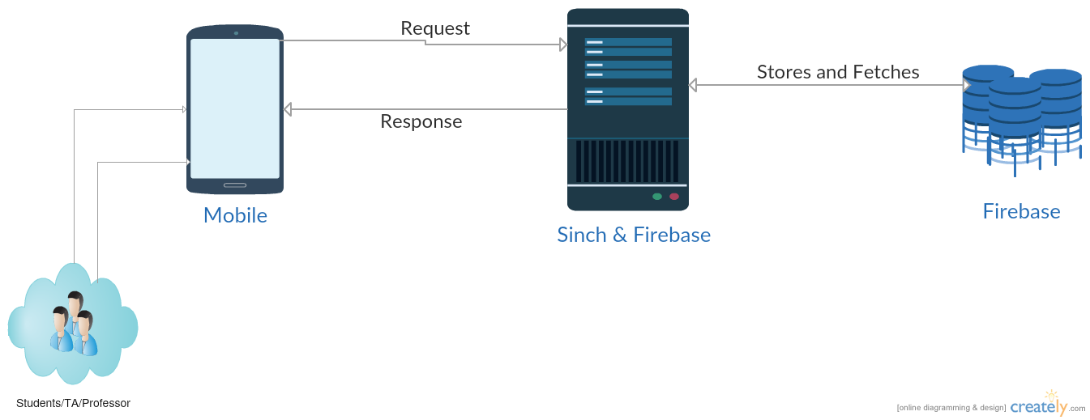
Software Architecture

Slide 4
TECHNOLOGIES
ANDROID STUDIO
FIREBASE
SINCH
VOLLEY

Slide 5
FEATURES
Connect with Friends ,TAs and Professors of your course easily by
App-App Chatting,
App-App Calling and
App-App Image Sharing
Robust and Secure Authentication.
Be on track with your course by staying notified of all updates and deadlines even when the app is in background.

